Slide 1
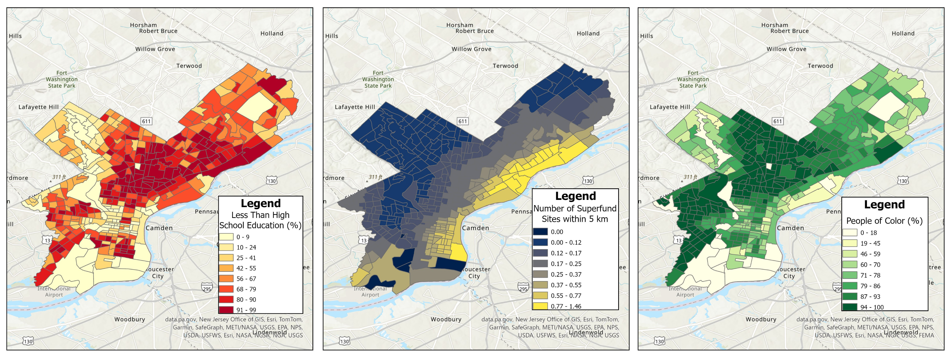
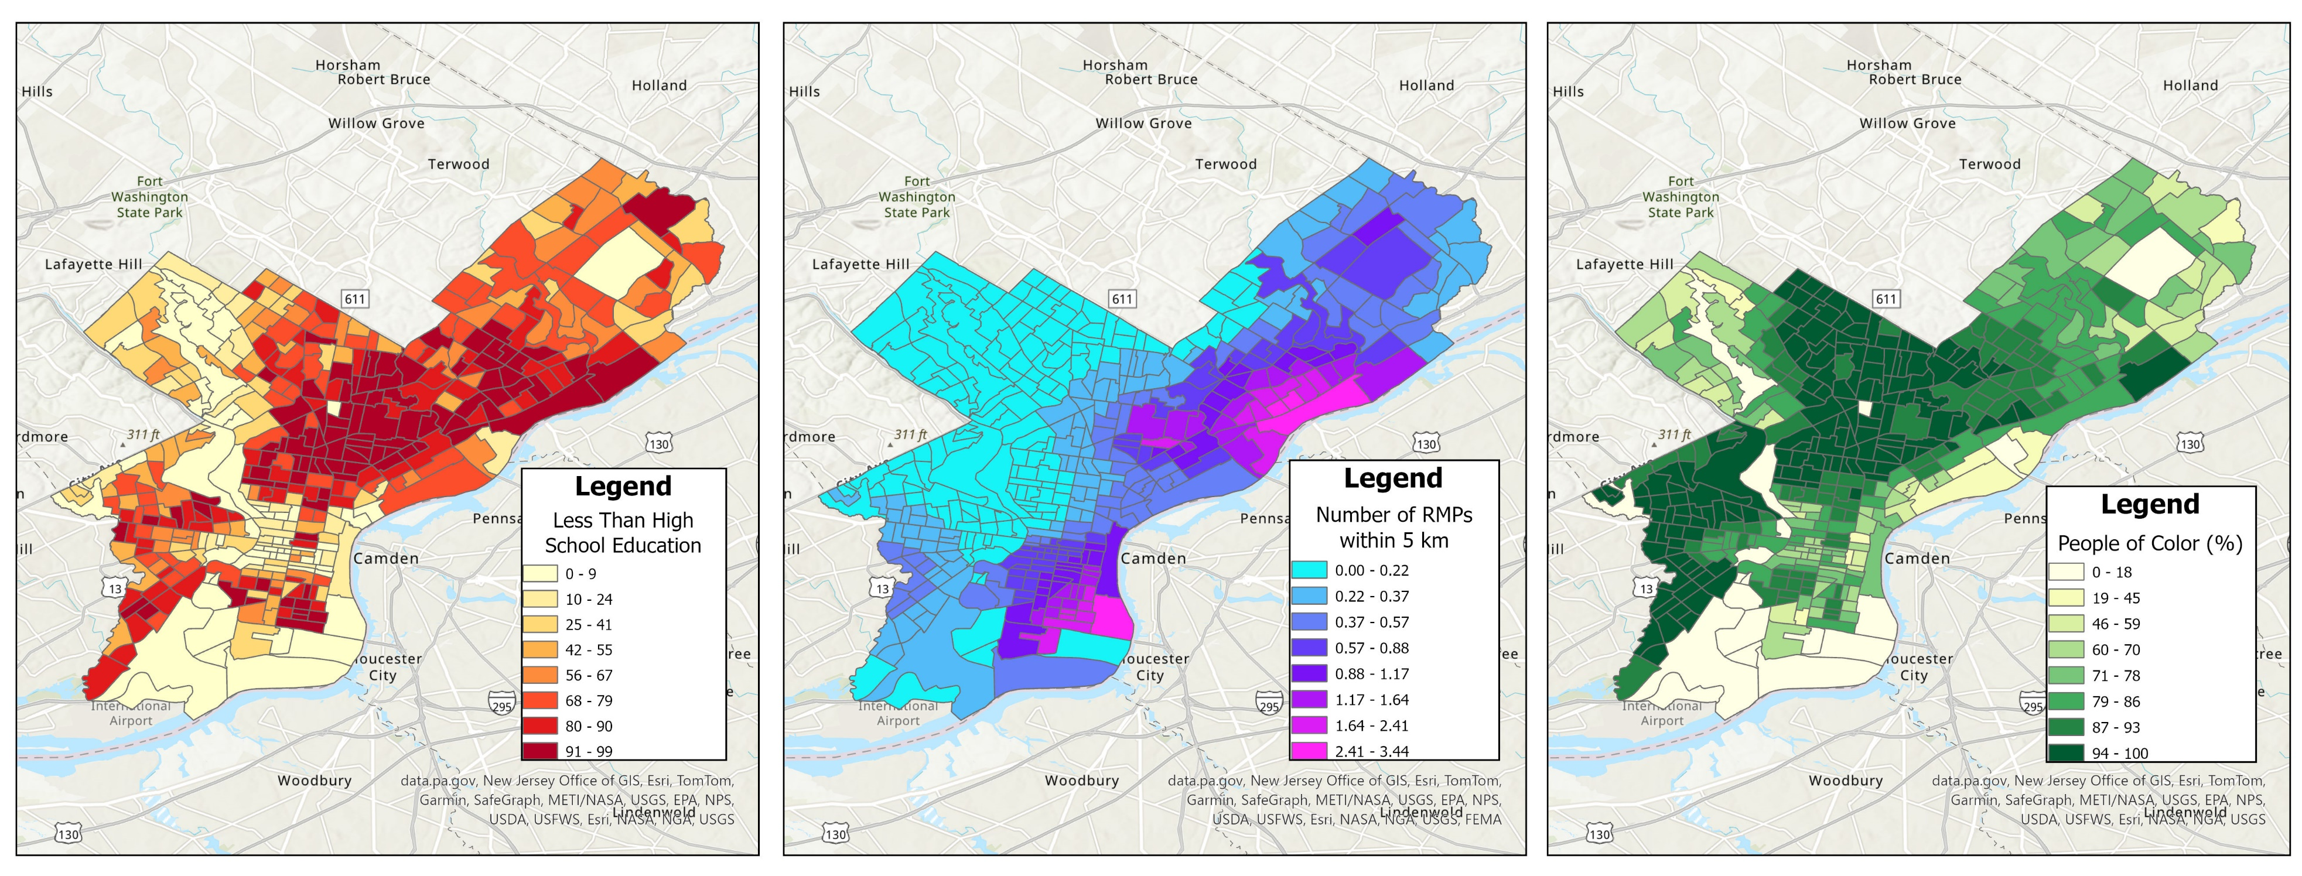
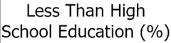
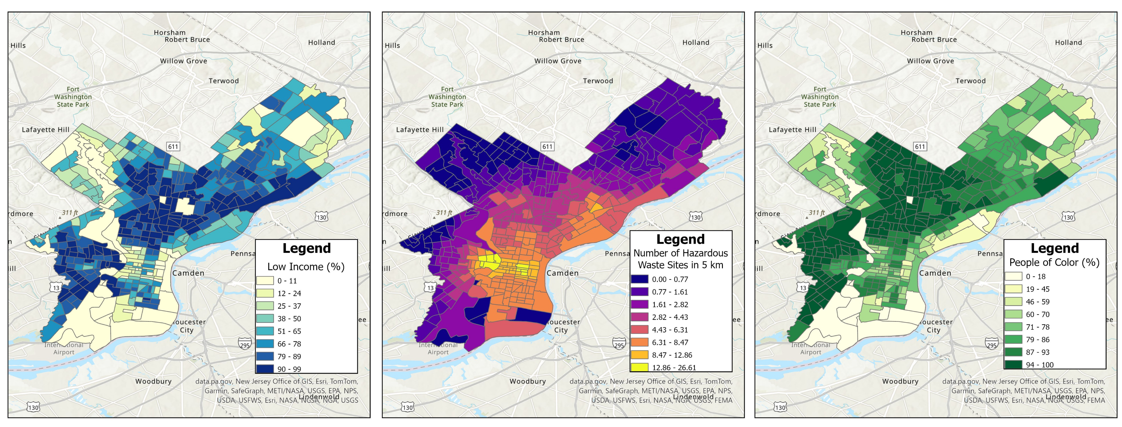
Pollution Site Proximity and its Relation to Socioeconomic Class in Philadelphia
Katherine Chu
Environmental Resource Management, College of Agricultural Sciences
Penn State University, State College, PA
ABSTRACT
Superfund Site Proximity in Relation to Less than High School Education and People of Color Percentage
RESULTS
Environmental justice concerns the relation between unhealthy environmental spaces to socioeconomic class.
Can occur after a history of underinvestment in vulnerable communities such as areas with high percentages of people of color and low- income individuals.
Current literature highlights the tendency of communities of poor socioeconomic class being located near polluted sites (Kramar et al., 2018).
Vulnerable neighborhoods in Philadelphia have suffered from environmental injustices in the past.
Acquiring health issues from soils contaminated with lead (Shea et al., 2021).
We can determine ways to better serve disenfranchised communities and keep in mind environmental equity in future redevelopments of polluted sites.
Significant Outcomes:
For Superfund site proximity:
For every unit of percentage of people with less than a high school education, there is a 3.18 higher number of Superfund sites with 5 km of the census tract.
For every unit of percentage of people of color, there is a 1.80 lower number of Superfund sites with 5 km of the census tract.
For RMP site proximity:
For every unit of percentage of people with less than a high school education, there is a 3.62 higher number of RMP sites with 5 km of the census tract.
For every unit of percentage of people of color, there is a 1.71 lower number of RMP sites with 5 km of the census tract.
For hazardous waste site proximity:
For every unit of percentage of low-income people, there is a 1.58 higher number of hazardous waste sites with 5 km of the census tract.
As for areas with higher percentages of people of color, there is a 1.55 lower number of hazardous waste sites with 5 km of the census tract.
Secondary Findings:
Less than high school education has a stronger relation to Superfund and RMP site proximity compared to other variables.
OBJECTIVES
Objective: Is there a tendency for low socioeconomic class communities in Philadelphia to be situated near sites of pollution?
Sites of pollution include superfund sites, risk management program (RMP) facilities, and hazardous waste sites.
HA: Communities that have either a high percentage of people of color, low income, limited English speaking, unemployment, and less than high school education are more likely to be near pollution sites.
H0: The socioeconomic class of communities have no relation to proximity of pollution sites.
RMP Proximity in Relation to Less than High School Education and People of Color Percentage
DISCUSSION & CONCLUSION
DATA & METHODS
Unexpected patterns between pollution sites and socioeconomic indicators.
Higher percentage of people of color within a census tract leads to fewer pollution sites within 5 km of the tract, supporting the null hypothesis.
People of color findings go against current literature, that African Americans are more likely to be near Superfund sites (Kramar et al., 2018; Alvarez & Evans, 2021).
Having a higher percentage of people with less than high school education correlates with increased Superfund and RMP sites within 5 km of the tract, supporting the alternative hypothesis.
A higher percentage of low-income people correlates with increased hazardous waste sites within 5 km of the tract, supporting the alternative hypothesis.
Correlates with Shea et al.’s findings relating elevated blood levels to children in poverty and proximity to demolition sites.
Need for more research:
Not many studies that specifically examine the relationship between level of education and proximity to pollution sites.
Assumption that with less than a high school education there would be less awareness or knowledge to resist pollution from occurring in their communities.
More research is needed to examine these relationships and what makes hazardous waste sites distinct from the other pollution sites.
Environmental Protection Agency’s EJScreen 2022:
EJScreen combines environmental data with demographic and socioeconomic data to improve accessibility for the public. The tool is updated annually.
Sample consists of census tracts within Philadelphia (N=403).
Dependent Variable: Pollution site proximity.
Consists of community’s proximity to superfund sites, RMP facilities, and hazardous wastes.
Each of these variables are measured as counts of sites within five kilometers of the target census tract.
Independent Variable: Low-socioeconomic class.
Includes percent low-income, percent unemployment rate, percent limited English speaking, and percent less than high school education.
Statistical Analyses: Regressions conducted via Stata v18 and spatial analysis done in ArcGIS Pro v3.2.2.
A multilevel Poisson/negative binomial regression model using “mepoission” and “menbreg.”
Dependent variables are each regressed on the independent variables at level 1.
At level 2, the census tracts are used to control differences between neighborhoods.
A chloropleth map will be made for each of the dependent variables and significant independent variables.
Hazardous Waste Proximity in Relation to Low Income and People of Color Percentage
Notes:
The Poisson regression model was used for both Superfund site proximity and RMP proximity due to their better fit.
The AIC for the Superfund Poisson model (426.18) was less than that of the negative binomial model (428.66).
The AIC for the RMP Poisson model (672.74) was less than that of the negative binomial model (772.59).
The negative binomial regression model was used for the hazardous waste site proximity instead since it had a better fit.
The AIC for the hazardous waste site Poisson model (1966.82) was greater than that of the negative binomial model (1963.17).

